Slide 1
Transmission Control Protocol
Presented By:
Sabin Nepal
Rajan Bhattarai
Achut Dahal
Aruna Shrestha

Slide 2
Table of content
Introduction to TCP
Features of TCP
TCP header
Connection management
Flow control
Error control

Slide 3
Introduction to TCP
A reliable, connection-oriented transport protocol
protocol for data transmission in communication network such as internet
provides a reliable stream delivery and connection service to applications
corresponds to the transport layer of TCP/IP suite
Used in World Wide Web (WWW),E-mail, File Transfer Protocol, Secure Shell, peer-to-peer file sharing, and some streaming media applications.

Slide 4
Features
Numbering system
Sequence number
Acknowledgement number
Error control
Flow control

Slide 5
Services
Process to process communication
Stream delivery service
Full duplex-communication
Connection-oriented service
Reliable service

Slide 6
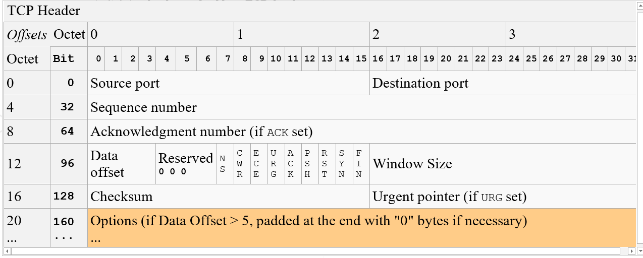
TCP header

Slide 7
TCP connection
Establishes a virtual path between source and destination
works in Server/Client model
TCP uses the services of IP to deliver individual segments, but it controls the connection itself
Transmission requires 3 phases
Connection established
Data transfer
Connection termination

Slide 8
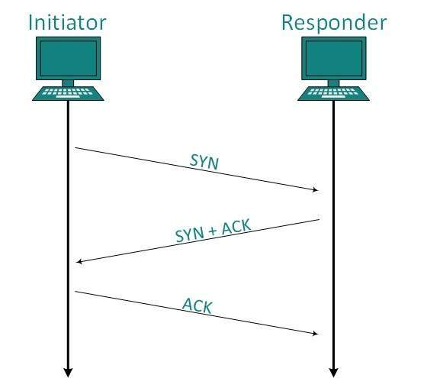
Connection Establishment
SYN:
Synchronization of sequence no’s
Consumes 1 sequence no
Carries no real data
SYN+ACK
SYN segment for communication in other
direction and ACK for the received SYN,
Consumes 1 sequence no
ACK
Just an ACK segment
Does not consume any sequence number

Slide 9
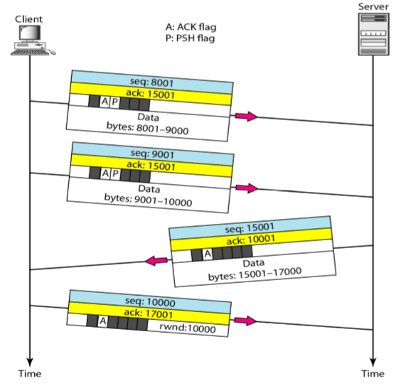
Data Transfer
Pushing data
Increase efficiency of data
Sending and receiving buffers the data
Delivers to application program on ready
Urgent data
Application program send urgent bytes
Sending application program want a piece
Of program to read out which is handled by
URG bit

Slide 10
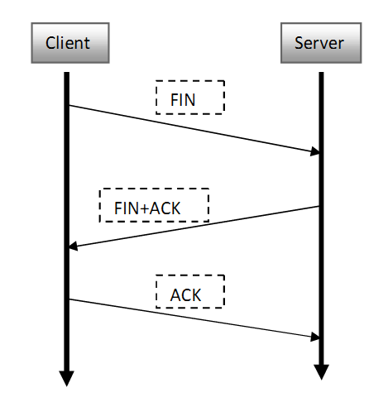
Connection termination
FIN
Consumes 1 sequence no
May or may not consume data
FIN+ACK
Consumes 1 sequence no
FIN announce closing of connection In other
Direction and ACK for received FIN
ACK
Does not consume any sequence no

Slide 11
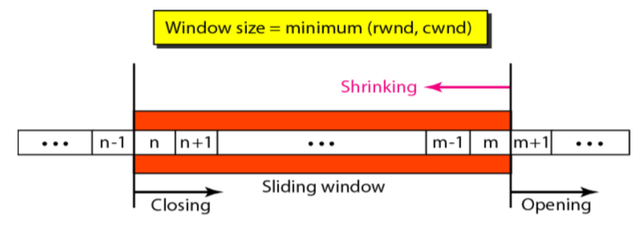
Flow Control
TCP uses sliding window to handle flow control
Technique to properly match the transmission rate of the sender to that of the receiver and network

Slide 12
Error Control
Error detection and correction is achieved of three simple tools
Checksum
Includes 16-bit checksum in every segment which is used to check for corrupt segment
If corrupted, it is discarded by destination TCP and is considered lost
Acknowledgement
TCP uses acknowledgement to confirm the receipt of data segments

Slide 13
ACK segments are never acknowledged
Retransmission
Lost, delayed or corrupted data are retransmitted
Segment is retransmitted either when a retransmission timer expires or when sender receives three duplicate ACK’s
Retransmission after RTO
Retransmission after 3 duplicate ACK’s
Out of order segments

Slide 14
References
https://www.tutorialspoint.com/data_communication_computer_network/transmission_control_protocol.htm
https://www.slideshare.net/k33a/transmission-control-protocol-tcp-31902778
https://www.slideshare.net/k33a/transmission-control-protocol-tcp-31902778

